Slide 1

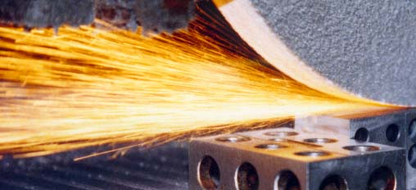
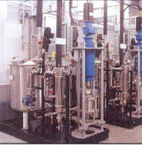
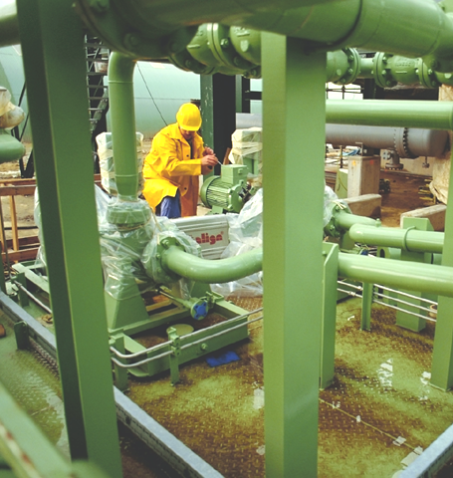


Costing for Oracle Process Manufacturing
AGSS Process Manufacturing Sales Support Team
Notes:
Costing and DBI are two more differentiators for Oracle. Our costing model is the most robust and flexible in the market, and our Daily Business Intelligence is the only offering that does NOT require a data warehouse to provide enterprise wide analytics.

Slide 2
Agenda
General concepts
Process Costing Solution
  Key Functionality
Additional resources

Slide 3


<Insert Picture Here>
General Concepts

Slide 4
Manufacturing Building Blocks
Analysis
Costing
Product
Development
Purchase
Order
Management
Planning
Produce
Quality
Inventory
Notes:
Review the components you’ve already talk about.

Slide 5
Process Costing and Daily Business Intelligence
Analysis
Costing
Product
Development
Purchase
Order
Management
Planning
Produce
Quality
Inventory
Notes:
Similar to Inventory and Quality, Costing and Analysis cover the entire suite. Unlike Inventory and Quality that are foundation components. Costing and Analysis leverage all the manufacturing data.
Costing pulls information from Product Development for standard costing and from Production Execution and Purchasing for actual costing. It also pushes information to Purchasing and Order Management. While Analysis pulls information from all the applications.

Slide 6

<Insert Picture Here>
Process Costing Solution

Slide 7
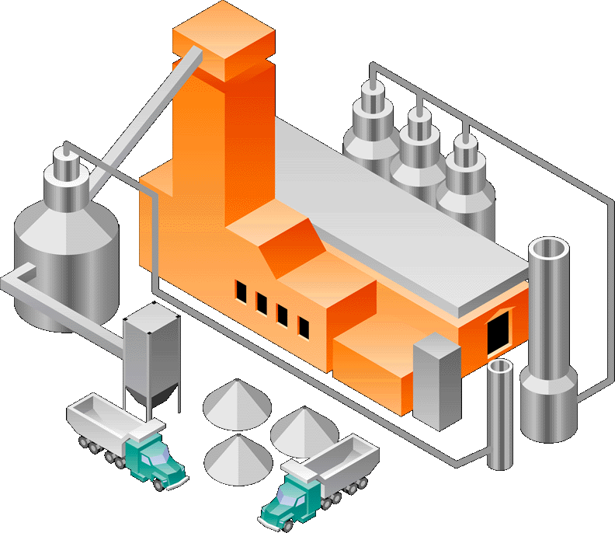

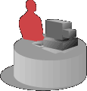



OPM Costing
Supports All Phases of Costing
Material
Acquisition
Overhead
Resource
Indirect
Actual
Standard
Lot
Composite
Cost
Development
Monitoring
Allocation
Analysis
Valuation
PWAC
PMAC
LAC
PPAC
Notes:
We saw this slide earlier in the Process Overview. I bring it up again here due to the significant importance of this capability within the Oracle solution. Costing and how users can model their cost models with OPM costing, has won deals for us.
So once again Cost Development –
Maintains multiple cost methods simultaneously
•Values different sets of items differently.
Example: Item ABC classes can be valued under different cost methods
•Compares Actual and Estimated operating costs
•Maximizes profit margins
•Evaluates make-or-buy decisions
•Analyzes historical trends
Cost Monitoring – Records cost information for each process, resource and burden activity associated with a product
•Monitors purchasing costs by vendor invoice or purchase order receipt
•Monitors acquisition prices for purchases
•Records actual purchasing and production unit costs
•Identifies specific activities that generate the direct and indirect production costs
•Tracks and acts on any unusual cost variations
Allocation –
•Records all costs that are neither directly convertible nor assignable to specific products
•Allocates expenses to items based on collected production statistics
•Supports activity-based costing using the generated data
Analysis –
•Performs detailed cost analysis
•Compares actual and estimated operating costs
•Produces cost transaction analysis reports
•Analyzes cost trends in the enterprise
•Compares and analyzes current and historical costs by periods, cost models, and items
•Performs a variety of cost variance summaries and consumption analysis
Valuation –
•Imports and Post journals in GL for OPM bookings
•Provides summarized or detailed journals in GL
•Drilldowns from GL to OPM transactions

Slide 8
Process Costing Solution
Enables you to:
Optimize profits and margins
Capture precise product costs
Facilitate proactive cost management
Assure proper accounting of resources & materials
Notes:
OPM Costing enables our customers to <review slide>.

Slide 9
Key Functionality
Multiple simultaneous costing methods
Flexible costing elements
Unlimited costing:
  Calendars
  Periods
  Groups
  Classes / Types
  Analysis codes
Current and historical cost analysis reports
Co-product and by-product costing
Costing engine independent of, but tightly linked to the General Ledger
Notes:
Here are some of the key functional differentiator for Oracle Process Costing offers to for Process Manufactures.

Slide 10
Simultaneous Multiple Cost Methods
Standard Costing
Calculates based on formula cost rollups
Actual Costing
Lot Costing
Calculates based on actual production data receipts and allocations
Composite / Hybrid
Costing
Hybrid of standard and/or actual
Notes:
One huge differentiators Process Costing offers is the ability to capture and use for analysis multiple cost methods simultaneously. Oracle is the only vendor who offers: Standard, Actual and Lot costing simultaneously.
Standard costing is usually used to track a baseline or budgeted cost. Also, used for items that where the costs do not change.
Actual cost methods captures costs of raw materials based on the raw material purchase order receipts and or invoices. Costs of products are captured based on the actual quantities of the raw materials consumed and the resource usage or conversion cost recorded in the production batch. Actual costs are typically capture to compare real production costs to the baseline/budgeted/standard cost, to provide production managers and other a clear idea of where their cost variances are coming from. OPM costing offers 4 different costing methods to allow our customers to use which ever give them better view of their business. If they would like to the could run all 4 at the same time although this is rare.
Lot costing is another actual cost method, but deserves to be discussed on it’s one. Lot costing is exactly what you may think it is; It lets users calculate
and store costs at the lot level. In other words, every lot has a unique cost associated
with it and that lot retains this cost until the entire lot is consumed. This method is most commonly used by disassembling processors and metals or any manufacture who’s cost vary greatly per each lot being processed.
The final cost we’ll talk about is hybrid/composite. This is the most powerful cost to position during a sales cycle. Customers always want to cost some items by the budgeted cost (items like: packaging, resources, labor), but also want to capture actual cost for their commodity items (i.e. oils, agricultural items, milk, etc). We can easily handle this need with composite costing.

Slide 11
Simultaneous Multiple Cost Methods
Effectively compare costs by using various methods
Standard Method
= 4.00
INVENTORY ACCTG
Actual Method,
Period Average = 3.75
SALES DEPT
Actual Method,
Perpetual Average = 3.45
06 BUDGET
Item
Lot Method
= 4.80
R & D - PROCESS
Notes:
Here is an example of the different costs and how they may be used and the different costs that may be calculated. <walk through slide>.

Slide 12
Actual Cost Averaging Algorithms
Perpetual Weighted Average (PPAC)
Period Moving
Average (PMAC)
Period Weighted Average (PWAC)
P-n
P-2
P-1
Current
Period (P)
Notes:
This chart will give you an idea of what is considered during each of the period average costs. Depending on the cost changes of a users items they may prefer on method over any other.
Describing Product Cost
Accessibility Description
The graphic describes product cost calculation.
General Notes
You can let OPM calculate actual costs of products, which is useful if you need to "spread" actual product costs for the period over more than one cost calendar period. For example, assume you have a steady level of production for 10 straight periods in a cost calendar. If production skyrockets in the 11th period, then production costs for that period skyrocket as well.
OPM uses one of the cost calculation methods to figure product cost so that those greater-than-usual product costs for the period are redistributed, and leveled, over a greater period of time.

Slide 13
Composite Cost Development
Model Commodities Costing Impact
Standard Cost
Item Set 1
Period Average
Item Set 2
Composite
Item Costs
Copy Cost
Process
Perpetual Average
Item Set 3
Notes:
Most of you probably figured there was a copying of cost routine involved to achieve the composite cost values and you were right. To accomplish a composite cost a user can copy any item or item class from the calendar they want to copy to the composite calendar.
The values being copied can be from different periods. Which give the user added flexibility on there costing capabilities.

Slide 14
Cost Calendars
Capture precise product costs
Different methods (standard, actual, etc)
Different periods
Any number of additional calendars for other business purposes:
  Ex: 2007, 12 Period, PWAC – Commodity Raw Materials
  Ex: 2007, 4 Period, LAC – Packaging Supplies
  Ex: 2007, 2 Period, STND – WIP, FG
  Ex: 2007, 52 Period, PMAC – Sales Dept Price Book
One for GL (ex. 2007, 12 Per, Composite Cost)
Copy costs between calendars
Notes:
In case you were wondering what I meant on the previous slide when I talked about different periods and calendars, we’re going to talk about them right now.
With OPM costing a user not only can have multiple cost methods, but they can also have multiple calendars and periods. A calendar can be look at as a block of time, while a period is a small block within the calendar. These are definable by the user (typically the Costing Manager / Director). One major benefit to cost accountants use OPM costing is their calendars and periods can be independent of their GL calendar and periods. This is necessary, due to cost accounts typically need/want a more granular view of their costs than GL periods allow them to get. This is a point that should be brought up in every discovery and demonstration.

Slide 15
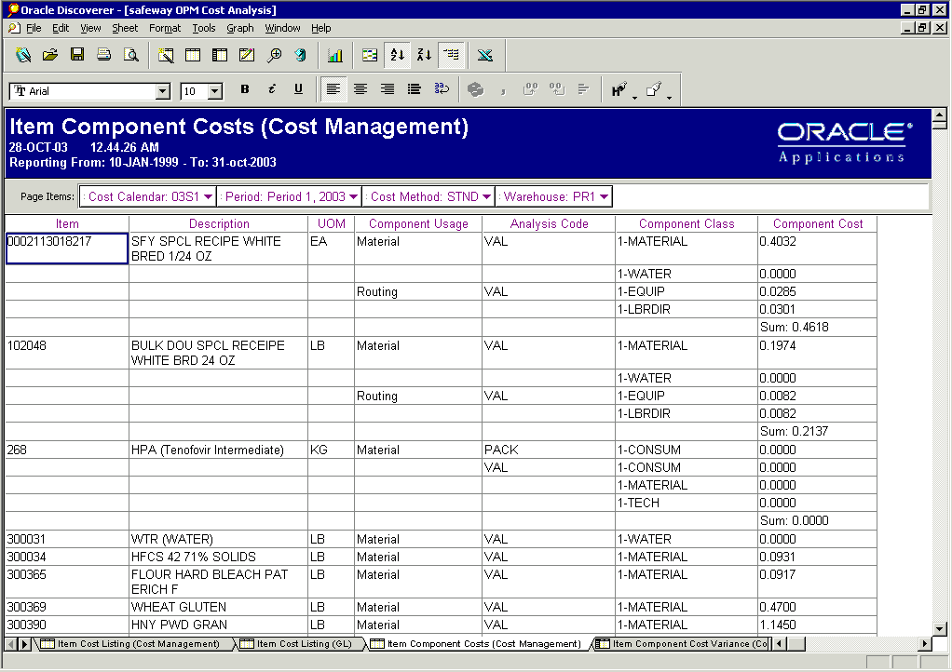
Unlimited: Groups – Codes – Classes
Notes:
In addition to user defined calendars and periods, using OPM Costing a user can create an unlimited costing groups, classes and codes. Once again this important to a process manufacturing cost accountant, because they need and want to see their costs on a very granular scale. Being able to identify the cost groups, classes and analysis codes that will help provide them with the information they need to make better decisions is a very welcomed surprise. Typically during this section of the discovery they look at you with disbelief. When you come back during the demo and show them, you are met with smiles and happiness from the same people.
<talk to the slide>

Slide 16
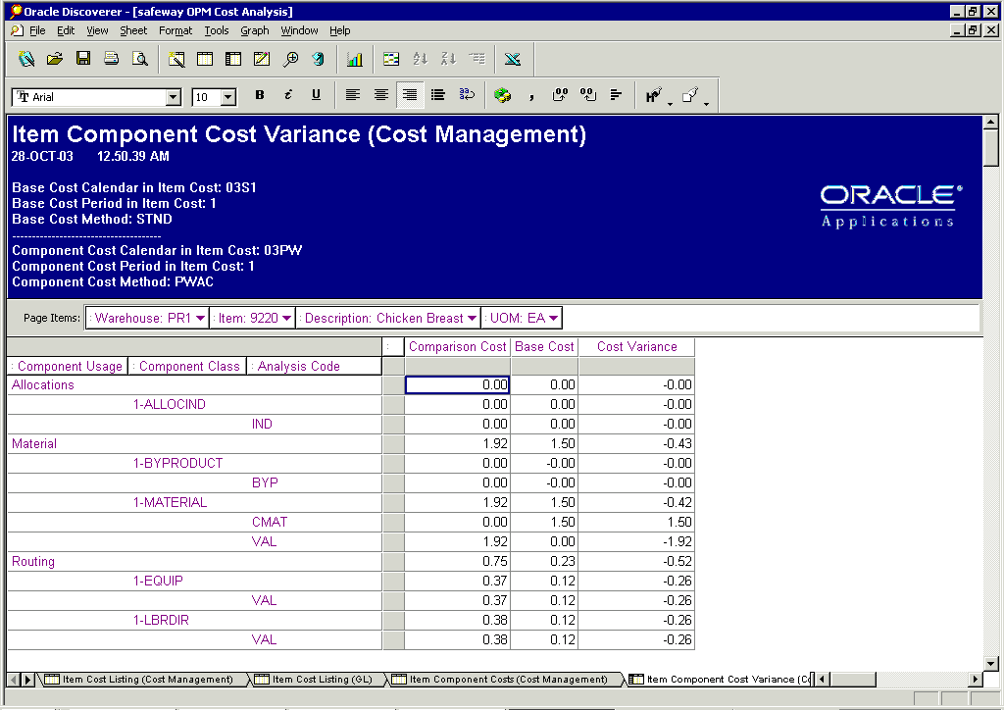
Cost Analysis
Facilitate Proactive Cost Management
Notes:
Because they can capture multiple costs, they can compare them side by side. Here is an example using our Discoverer report writer giving a variance view.

Slide 17
Co-Product and By-Product Costing
Manage process specific costing issues effectively
Chicken
Wings
Breast
Feathers
Co-Product
Product
By-Product
  By Products could have + cost or a – cost
  Co- Products costed based on Cost Allocation Factors
Notes:
Another costing issue most process manufactures struggle with is accounting for by-products and co-products. This is due to most software systems do not handle this in their costing model.
SAP is one of the ones who can not handle this properly. They must model by-product costs by using negative balances within their BOM. This gives bogus inventory balances which leads to bogus inventory costing. If you can, you want to find something in a prospects process that would be tracked as a by-product they can resell. To highlight this capability and differentiate Oracle.

Slide 18
Subledger Accounting
OPM Costing with SLA
Completed material and
resource transactions
OPM Costing engine
generates cost
Cost Preprocessor
creates
accounting events
SLA processes these
events to create
journal entries
Notes:
The graphic shown here shows the costing and accounting process from OPM to the GL via SLA.
This topic typically doesn’t come up in a demo, unless you are trying to broad an installed Oracle footprint with OPM. In these accounts they typically are using SLA for AP and AR and are comfortable with it’s functionality. You can leverage OPM uses the same sub ledger functionality they know and use.

Slide 19
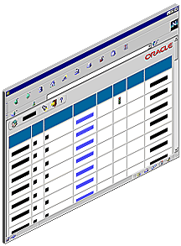
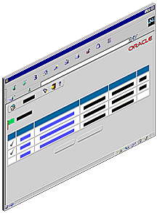
Drilldown
End to end drilldown capabilities
Drill down from GL to
Sub-Ledger data to
Cost transactions
Notes:
Also, leveraging the drilldown capabilities they have from GL to AR and/or AP will also apply with manufacturing transactions.

Slide 20
Process Costing Solution
Enables you to:
Optimize profits and margins
  Multiple cost methods: standard, actuals, lot, composite
Capture precise product costs
  Co-products, by-products, unlimited cost elements, cost allocations
Facilitate proactive cost management
  Cost monitoring, cost analysis
Assure proper accounting of resources & materials
  Flexible account mapping, sub-ledger flow, drilldowns
Notes:
In summary <review slide>.

Slide 21

<Insert Picture Here>
Additional Resources

Slide 22
Additional Resources
E-Business Suite Portal
  http://apps.oraclecorp.com/ebs-home.html
Data sheets
  OPM Costing
    http://files.oraclecorp.com/content/AllPublic/SharedFolders/E-Business%20Suite%20Process-Public/Launch/R12/Data_Sheets/Process%20Mfg/ds_OPM_costing.pdf
  Daily Business Intelligence for Manufacturing
    http://apps.oraclecorp.com/products/sales/docs/r12-datasheets/cpm/R12_DBI_for_Manufacturing_DataSheet.pdf
Notes:
Here are a couple links you can use to access additional information concerning Oracle Process Costing, Daily Business Intelligence for Manufacturing and Oracle’s Process Manufacturing solution.

Slide 23
Additional Resources
Vivian Lewis – AGSS – SCM Solution Specialist
  Vivian.Lewis@oracle.com
  Mobile 972-xxx-xxxx
Andrew Hyers – AGSS – SCM Solution Specialist
  Andrew.hyers@oracle.com
  Mobile 502-xxx-xxxx
David Ballin – AGSS – SCM Solution Architect
  David.ballin@oracle.com
  Mobile 201-218-3245
  Office 201-794-6221
Notes:
Here are a couple links you can use to access additional information concerning Oracle Inventory and Oracle’s Process Manufacturing solution.
You may also contact Linda and/or David for assistance in positioning or questions around Oracle Process Manufacturing solution and/or Process Manufacturing Industries.

